Slide 1


Addressing Assumption Violations: Independent Errors
Wake Forest
School of Business
_______
BAN 7070

Slide 2
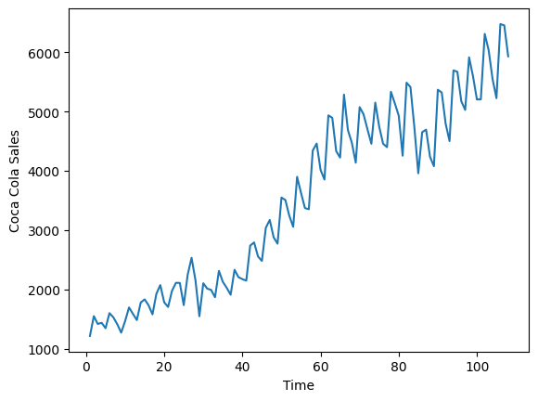
Coke Sales Data

Slide 3
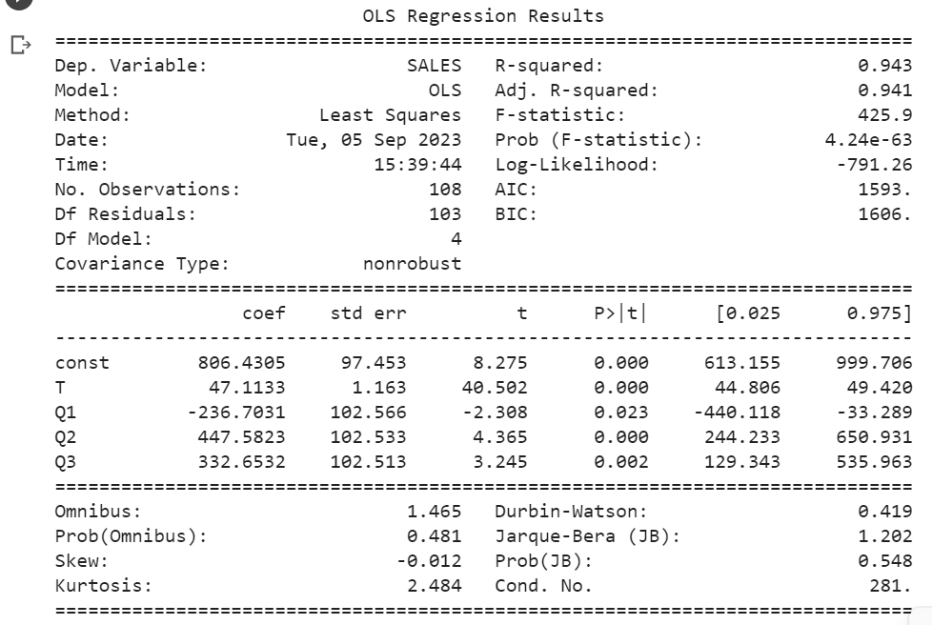
Coke Sales Regression

Slide 4
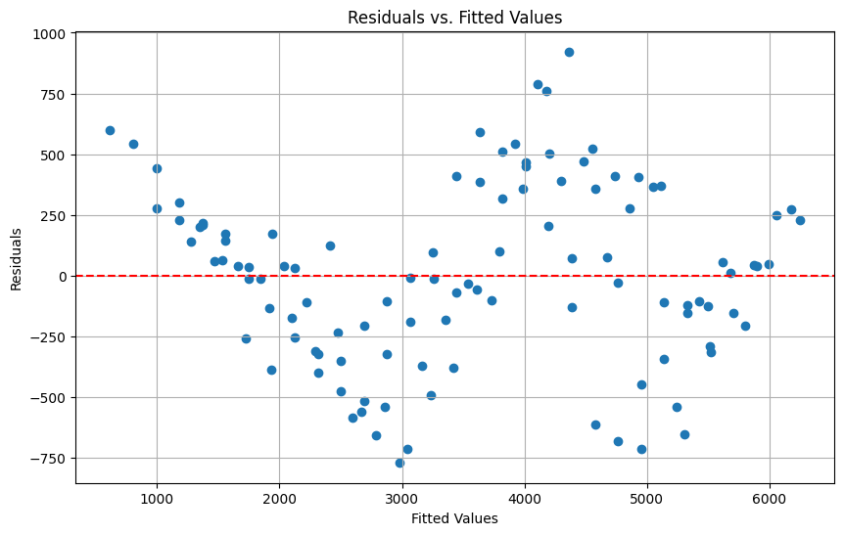
Coke Residual Plot

Slide 5
Autocorrelation and White Noise
A white noise series
Varies randomly around its mean
Has no systematic variation
Comprised only of random variation
If the error terms are independent, the residuals will be white noise
If the error terms are not independent, the residuals will exhibit autocorrelation, meaning that values of y at the current time period are correlated with values of y at past time periods

Slide 6
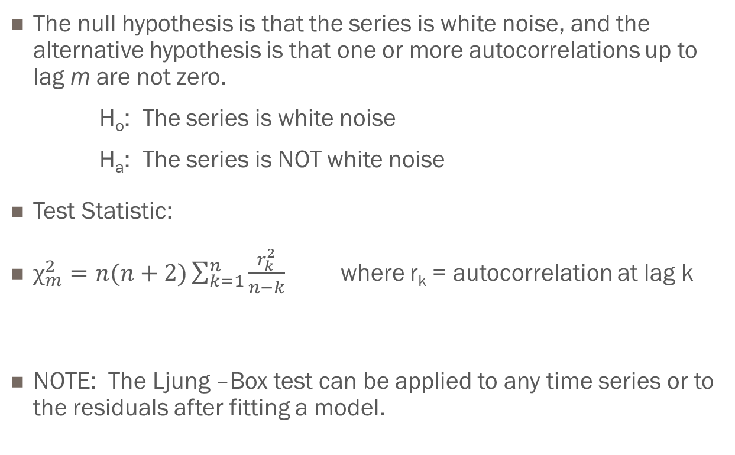
Ljung-Box Chi-Square Test for White Noise
The null hypothesis is that the series is white noise, and the alternative hypothesis is that one or more autocorrelations up to lag m are not zero.
H_{o}: The series is white noise
H_{a}: The series is NOT white noise
Test Statistic:
$χ_{m}^{2}=n(n+2)\sum_{k=1}^{n}{\frac{r_{k}^{2}}{n−k}}$ where r_{k} = autocorrelation at lag k
NOTE: The Ljung –Box test can be applied to any time series or to the residuals after fitting a model.

Slide 7
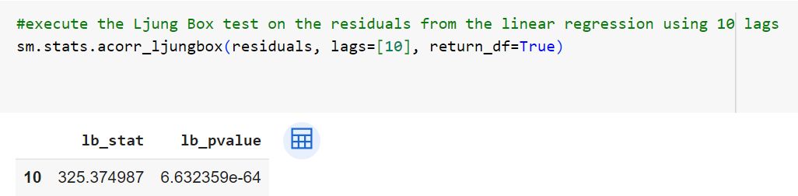
Ljung-Box Test for Coke Data

Slide 8
Addressing Autocorrleation in a Linear Regression Model
Model Assumption: Independent Error Terms
When this assumption is violated, the scatterplot of the residuals vs predicted values will show an oscillating pattern
This pattern is evidence of autocorrelation in the residuals
You can use the Ljung-Box test to assess the degree of autocorrelation
What to do if the assumption is violated:
Add one (or more) lagged values of the response variable to the set of explanatory variables for the model

Slide 9
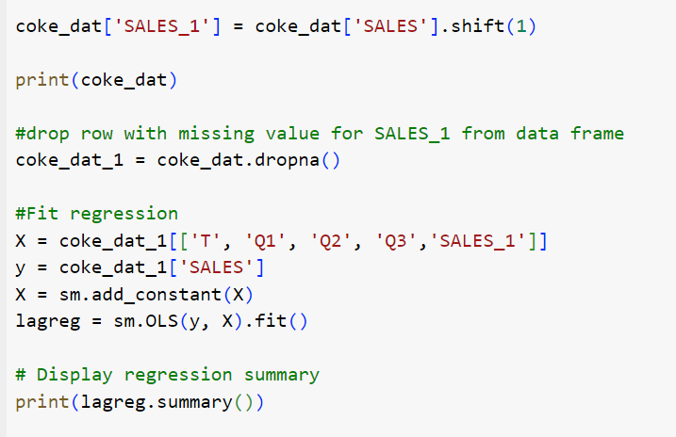
Adding a lagged term to the Coke Model

Slide 10
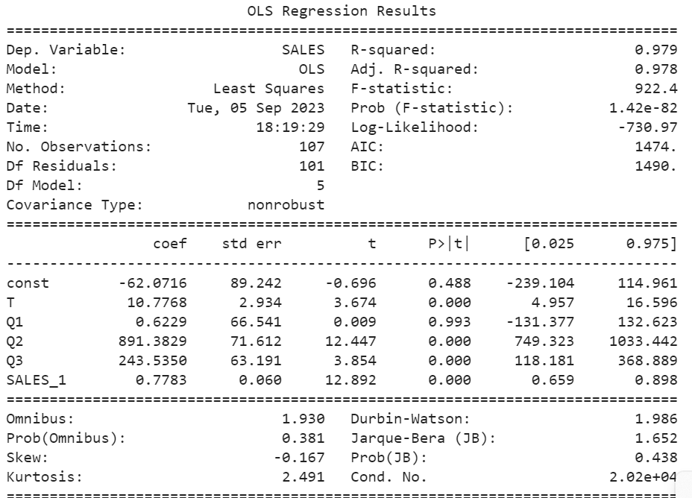
Adding a lagged term to the Coke Model

Slide 11
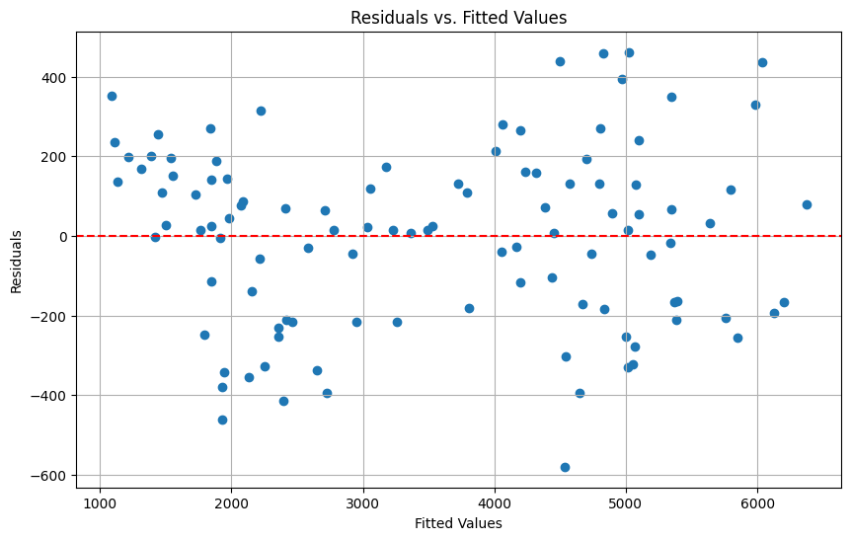
Adding a lagged term to the Coke Model

